Slide 1

Project Presentation of CO-OP Project at Industry (Module-2) (22CS421) on
Fake News Detection using Machine Learning:
A Comparative Study of Classical Supervised Learning Algorithms
Akshat Mittal
Roll No.: 2210991228
Supervised By
Dr. Simarjit Kaur
Associate Professor
Department of Computer Science and Engineering,
Chitkara University, Punjab

Slide 2
Agenda
01
Introduction & Problem Statement
02
Dataset Overview
03
Methodology
04
Tools & Technologies
05
Key Results
06
Feature Interpretability
07
Conclusion & Future Scope
2

Slide 3
Introduction & Problem Statement
The Problem
Project Objectives
Misinformation spreads faster than corrections on social media
Scale: Hundreds of millions of posts/day — impossible to fact-check manually
Automated classification can intervene at publication time
Classical ML: fast, interpretable, deployable at scale
Compare 5 classical ML classifiers under identical conditions
Evaluate 4 vectorization (N-gram) schemes as a primary variable
Identify linguistic features predictive of fake news
Establish a reproducible, deployable baseline
44,898
5
4
99.9%
Total Articles
Classifiers Tested
Vectorization Schemes
Best Accuracy
3

Slide 4
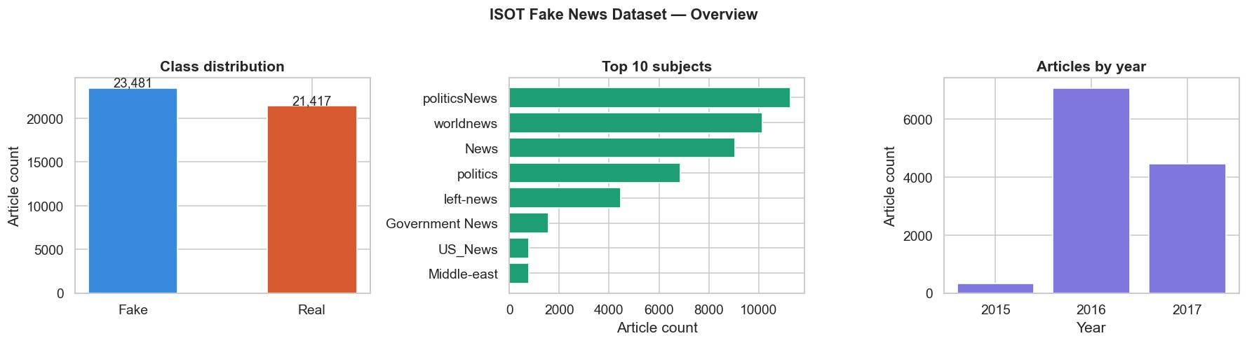
Dataset Overview — ISOT Fake News Dataset
Source: University of Victoria — Real articles from Reuters; Fake from PolitiFact-flagged outlets
44,898 articles total: 23,481 Fake (52.3%) | 21,417 Real (47.7%) — near-balanced classes
US political & international news, 2015–2017 | Headline + body text used; metadata excluded
Fig. 1 — ISOT Dataset: class distribution, top subjects, articles by year
4

Slide 5
Methodology
1. Preprocessing
2. Vectorization
3. Classification
4. Evaluation
Lowercase, remove URLs
Tokenise (NLTK)
Stop-word removal*
WordNet Lemmatise
BoW Unigrams
TF-IDF Unigrams
TF-IDF Bigrams
TF-IDF Uni+Bi
Logistic Regression
SVM (linear)
Random Forest
Naïve Bayes
Passive-Aggressive
Accuracy, Precision
Recall, F1-score
Confusion matrix
Training time
▶
▶
▶
* First-person plural pronouns (we, our, us) retained for rhetorical relevance | 80/20 stratified split | 5-fold CV hyperparameter tuning | 50,000 max features
5

Slide 6
Tools & Technologies
Python
NLTK
Core language — End-to-end pipeline implementation
NLP / Preprocessing — Tokenisation, stop-words, WordNet lemmatiser
scikit-learn
NumPy & pandas
ML & Evaluation — 5 classifiers, TfidfVectorizer, GridSearchCV
Data handling — Array ops, dataframe management, splitting
Matplotlib & seaborn
WordCloud
Visualisation — Heatmaps, confusion matrices, scatter plots
Text viz — Vocabulary contrast word clouds
Hardware: AMD Ryzen 4800H | 16 GB RAM
6
6

Slide 7
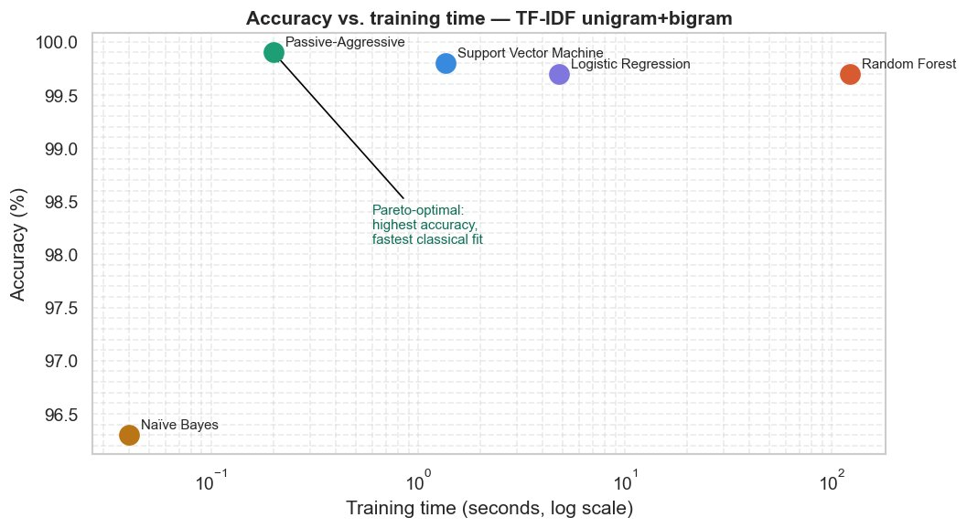
Key Results — Classifier Comparison
Classifier | Accuracy (%) | Precision | Recall | F1-Score | Train Time (s)
Logistic Regression | 99.7 | 0.997 | 0.997 | 0.997 | 3.8
Support Vector Machine | 99.8 | 0.998 | 0.998 | 0.998 | 1.1
Random Forest | 99.7 | 0.997 | 0.997 | 0.997 | 138.5
Naïve Bayes | 96.3 | 0.963 | 0.962 | 0.963 | 0.1
Passive-Aggressive ★ | 99.9 | 0.999 | 0.999 | 0.999 | 0.2
Fig. — Accuracy vs. Training Time (log scale)
7
Test set: n = 8,980 | TF-IDF Unigrams + Bigrams | ★ = Pareto-optimal (best accuracy + fastest training)

Slide 8
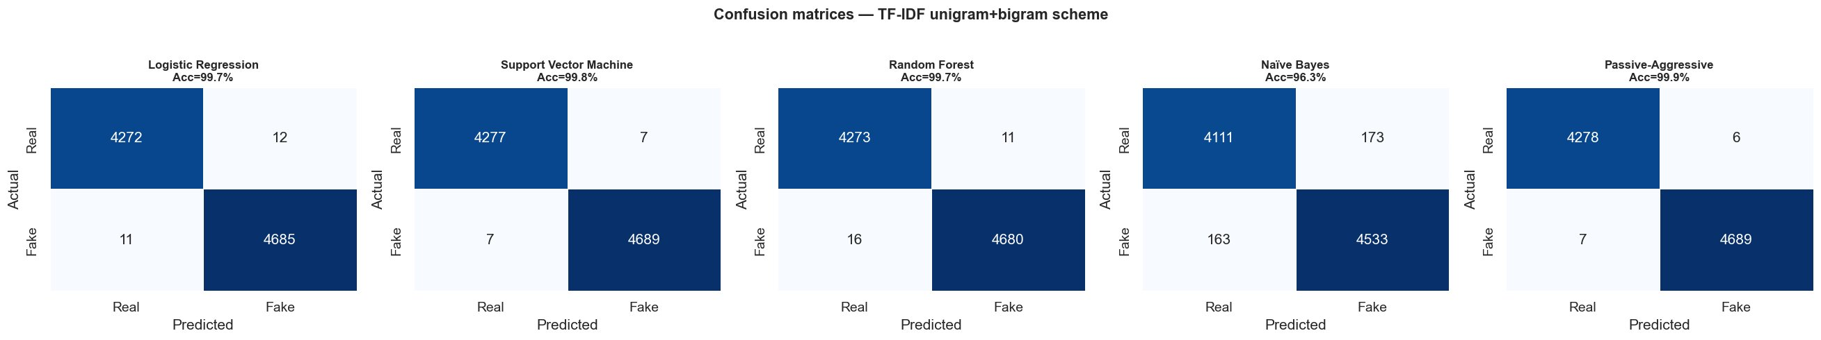
Key Results — Vectorization Schemes
Key Insights
Uni+Bigrams best at 99.9% — phrase-level features add real signal
Bigrams-only (99.4%) < Unigrams (99.8%) — phrases alone lose single-term coverage
BoW (99.6%) lags TF-IDF by up to 0.5 pp — IDF weighting consistently helps
Within the 4 stronger classifiers, scheme spread (0.5pp) > within-scheme spread (0.2pp)
Fig. — Confusion matrices, all 5 classifiers (TF-IDF Uni+Bigrams) | PAC: only 13 errors from 8,980 articles
8

Slide 9
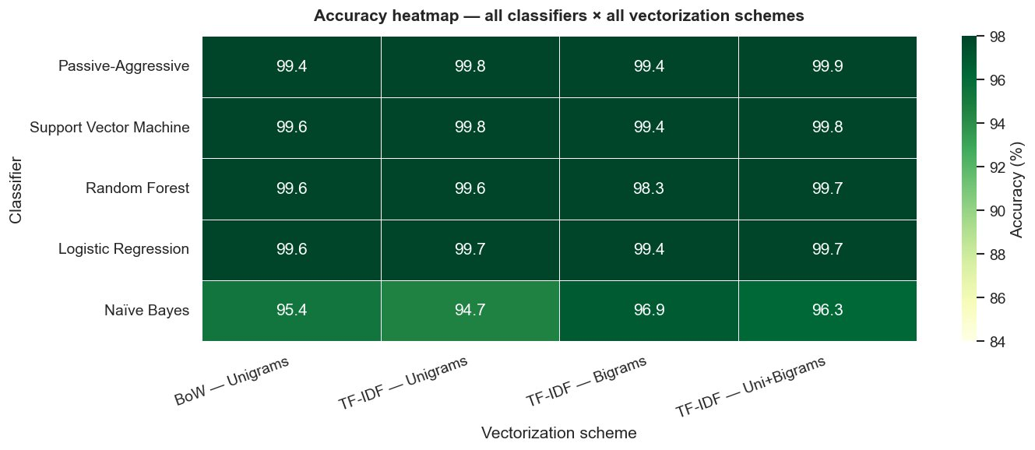
Accuracy Heatmap — All Classifiers × All Schemes
Fig. 5 — Accuracy (%) for all 5 classifiers across all 4 vectorization schemes. Range: 94.7% – 99.9%.
PAC achieves 99.9% (Uni+Bigrams) — highest across all 20 model–scheme combinations
Naïve Bayes is consistently the lowest — independence assumption violated in news text
All 4 stronger classifiers ≥ 98.3% under every scheme — robust baseline
9

Slide 10
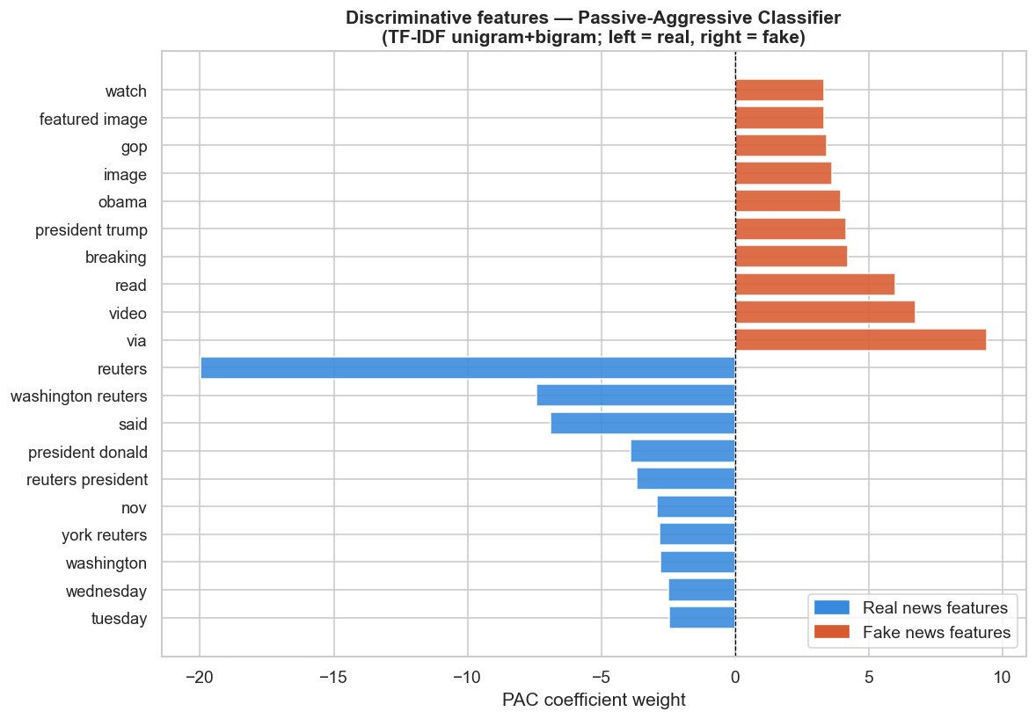
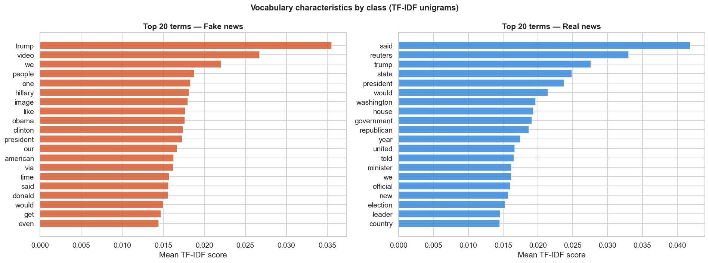
Feature Interpretability — What Signals Distinguish Fake from Real?
Fig. 7 — Top 20 TF-IDF terms by class
Fig. 8 — PAC coefficient weights
✔ Real News Vocabulary
✘ Fake News Vocabulary
"reuters" — dominant feature (coeff ≈ −20)
"washington reuters", "york reuters" — bigram source tags
"said", "wednesday", "tuesday" — dateline & attribution markers
Wire-service style: structured, source-attributed, dateline-anchored
"via" — top fake feature (coeff ≈ +10), media-embed artifact
"video", "read", "image", "featured image" — hyperlink-heavy layouts
"breaking", "obama", "gop" — urgency & political charge
Affect-driven, media-embedding, personality-centred rhetoric
10

Slide 11
Conclusion & Future Scope
Key Conclusions
PAC + TF-IDF Uni+Bigrams: 99.9% accuracy, F1 = 0.999, training in 0.2 s
Result meets or exceeds fine-tuned transformer benchmarks (FakeBERT ≈ 98.9%) — at far lower cost
Vectorization is a primary design variable: Uni+Bi > Unigrams > BoW > Bigrams-only
Clear linguistic signature: source-attribution (real) vs. media-embedding & political charge (fake)
Future Scope
01
Direct head-to-head comparison with DistilBERT on the same test partition with matched hardware and reported latency
02
Add stylometric features (punctuation density, modal verb frequency, readability scores) for adversarial robustness
03
Cross-domain evaluation: apply ISOT-trained model to health & financial fake news datasets; measure accuracy decay
11

Slide 12
Thank You
Akshat Mittal | B.E. CSE | Chitkara University, Punjab
akshat1228.be22@chitkara.edu.in
12

